Slide 1
COVID-19 VACCINE ANALYSIS OPTIMIZING DEPLOYEMENT STRATERGIES
PHASE 2

Slide 2
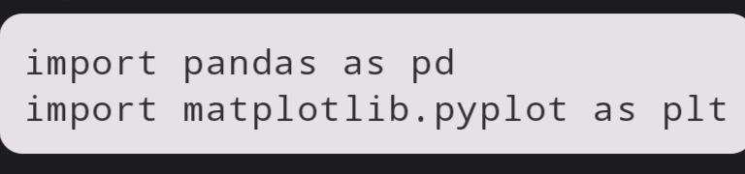
IMPORT LIBRARIES
This code imports the necessary Python libraries, including Pandas for data handling and Matplotlib for data visualization.

Slide 3
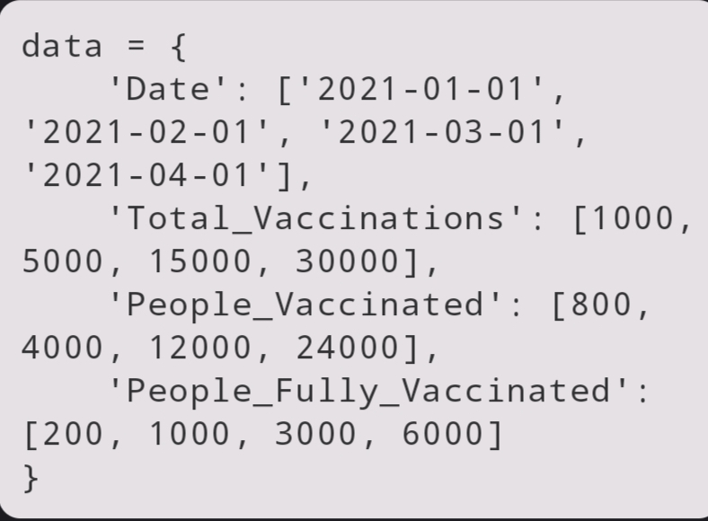
SAMPLE VACCINATION DATA
This code defines a sample dataset with columns for "Date," "Total_Vaccinations," "People_Vaccinated," and "People_Fully_Vaccinated." You would replace this with your actual dataset.

Slide 4
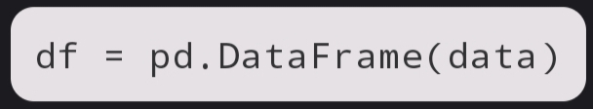
CREATE A DATA FRAME
Here, the sample data is loaded into a Pandas DataFrame. In a real-world scenario, you would load your dataset using `pd.read_csv()` or another suitable method.

Slide 5
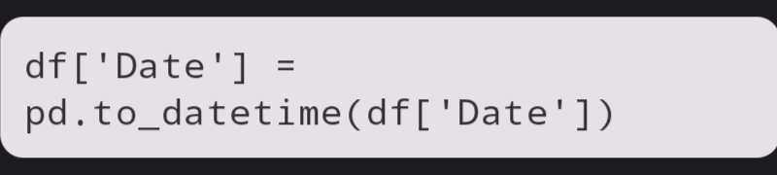
CONVERT ‘DATE’ TO ‘DATE TIME’
This code converts the 'Date' column to the datetime format, which is necessary for working with date-based data.

Slide 6
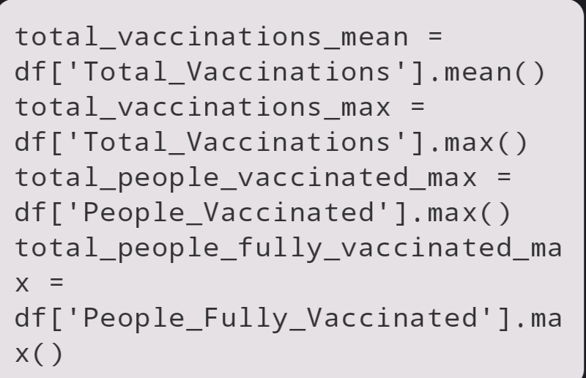
BASIC STATISTICS
Calculate basic statistics, including the mean and maximum values for various vaccination-related columns.

Slide 7
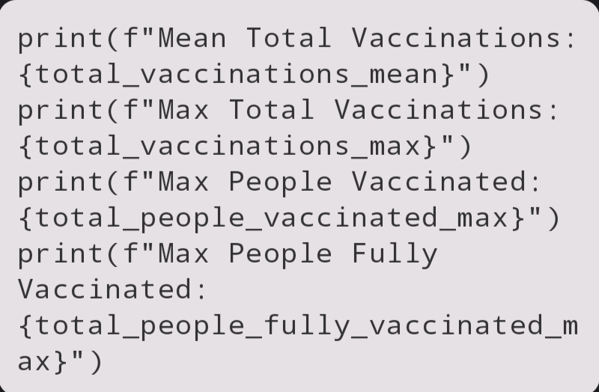
PRINT STATISTICS
Print the calculated statistics to the console.

Slide 8
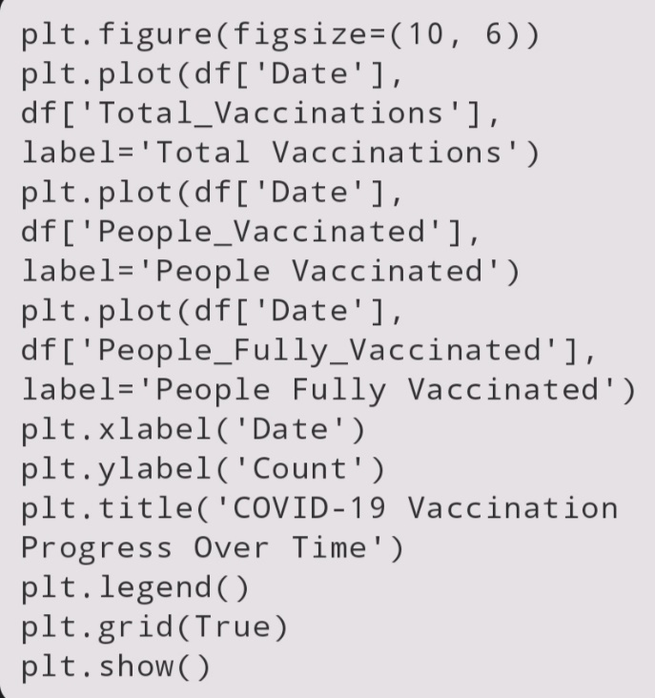
PLOT THE DATA
This code creates a line plot that visualizes the vaccination progress over time for different categories. It sets labels, titles, legends, and gridlines to make the plot informative.
Now, when you run this code, you'll get a plot showing the COVID-19 vaccination progress over time, along with basic statistics printed to the console.

